Slide 1

There are many reasons to not
buy an electric vehicle.
Notes:
ev drivers
meralco
supplementary yung community based build

Slide 2

1:48
estimated EV Charging Stations to EV ratio as of mid-2025
10-15%
projected peak grid strain for 100,000 EV fleet by 2030
Notes:
ev drivers
meralco
supplementary yung community based build
grid strain -> could overwhelm grid -> to mitigate this, rotational brownouts are put in place to protect the system from a total blackout
ph grid is ~80% fossil fuel dependent -> fossil fuels arent flexible, they cant be “stopped”, they aksi cant keep up with sudden demand surges (eg.EVs charging sabay sabay). (di nya kaya mag spike agad)
grid faces 10–15% peak load strain not because it uses fossil fuels, but because its fossil-dependent structure lacks the flexibility to handle sudden EV charging spikes, especially when many drivers charge at the same time.
presentation should say smth abt we should be equipped for the future (code the future theme)
https://cleantechnica.com/2025/10/07/an-experts-analysis-on-how-the-philippines-can-navigate-its-electric-vehicle-transition/?utm_source=chatgpt.com

Slide 3

1:48
estimated EV Charging Stations to EV ratio as of mid-2025
10-15%
projected peak grid strain for 100,000 EV fleet by 2030
Charging the Future of Electric Vehicles
Notes:
ev drivers
meralco
supplementary yung community based build
grid strain -> could overwhelm grid -> to mitigate this, rotational brownouts are put in place to protect the system from a total blackout
ph grid is ~80% fossil fuel dependent -> fossil fuels arent flexible, they cant be “stopped”, they aksi cant keep up with sudden demand surges (eg.EVs charging sabay sabay). (di nya kaya mag spike agad)
grid faces 10–15% peak load strain not because it uses fossil fuels, but because its fossil-dependent structure lacks the flexibility to handle sudden EV charging spikes, especially when many drivers charge at the same time.
presentation should say smth abt we should be equipped for the future (code the future theme)
https://cleantechnica.com/2025/10/07/an-experts-analysis-on-how-the-philippines-can-navigate-its-electric-vehicle-transition/?utm_source=chatgpt.com

Slide 4

Charging the Future of Sustainable Transport

Slide 5
1
Primary Objectives
For EV Drivers
For Relevent Agencies
For Households and SMEs
2
Eliminate EV Driver Anxiety and Encourage EV Use
Provide Useful, Precautionary, and Predictive Data on EV Use
Create a Business With the Community at Its Core

Slide 6
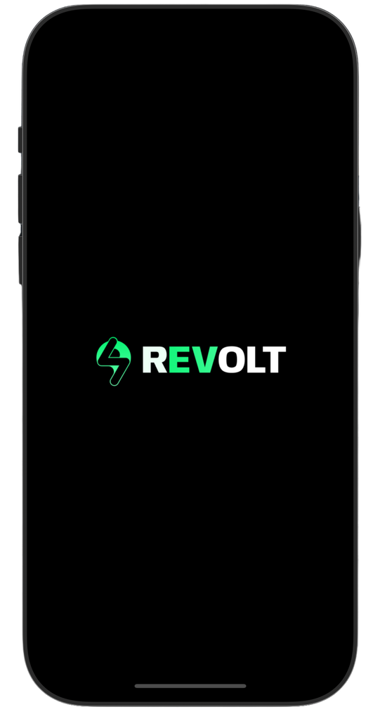
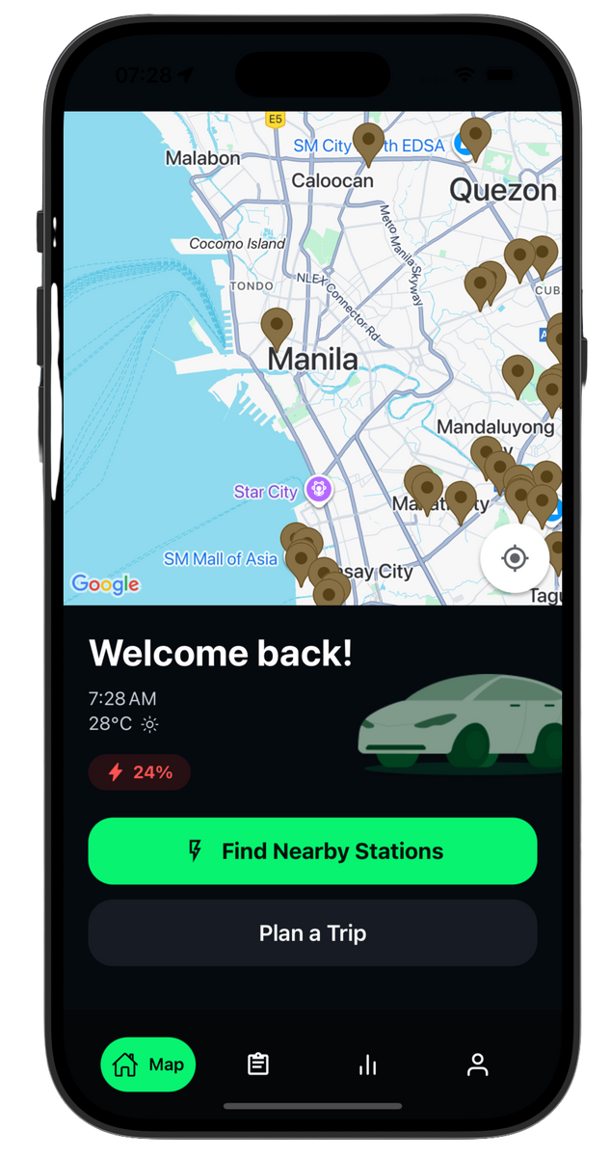




Smart Routing
Recommends the best routes based on distance, battery capacity, and station availability, and risks of the route
EV Use Monitoring
Collates EV use and trends from clusters into a dashboard for power monitoring and management
Peer-to-Peer Renting
Allows households and SMEs to join the charging network through the app

Slide 7
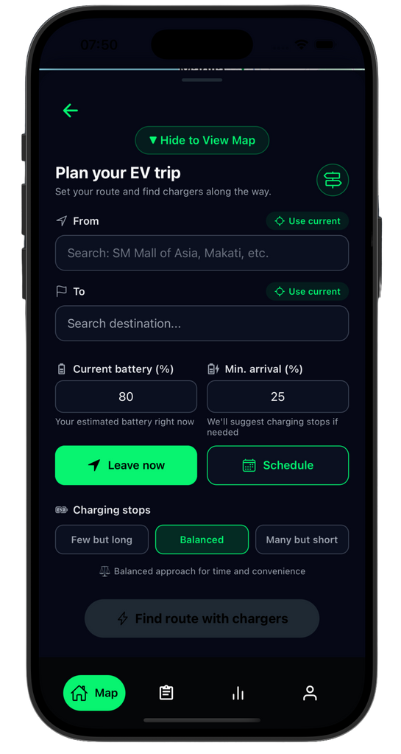
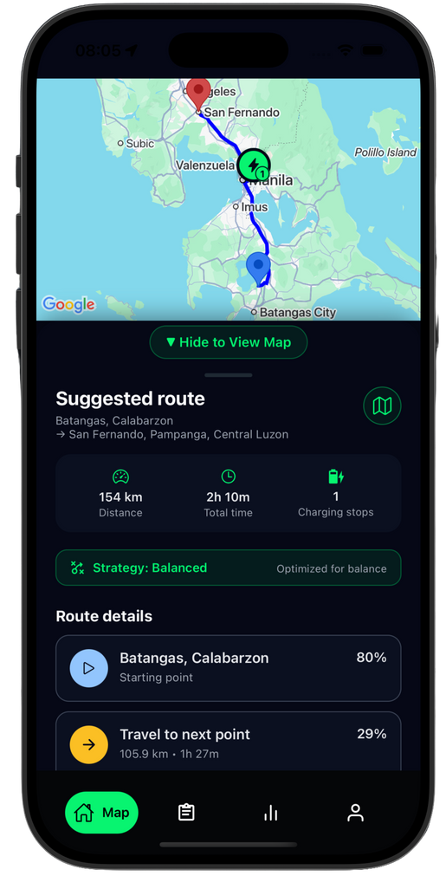
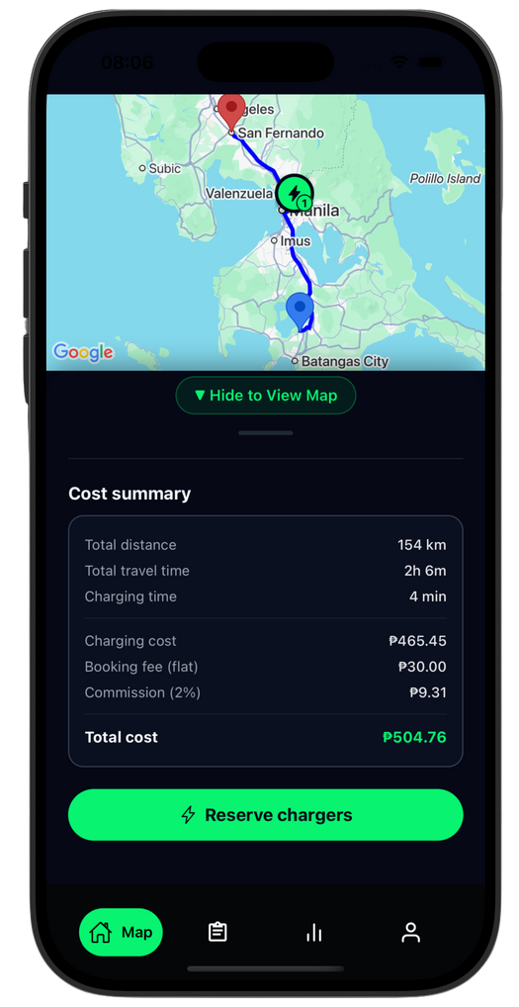
Smart Routing
Recommends the best routes based on distance, battery capacity, and station availability, and risks of the route

Slide 8
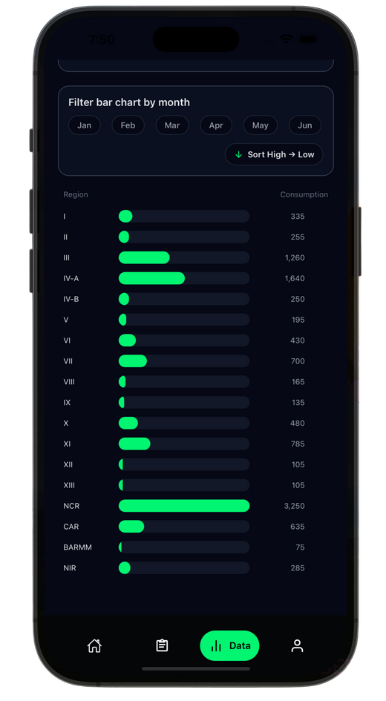
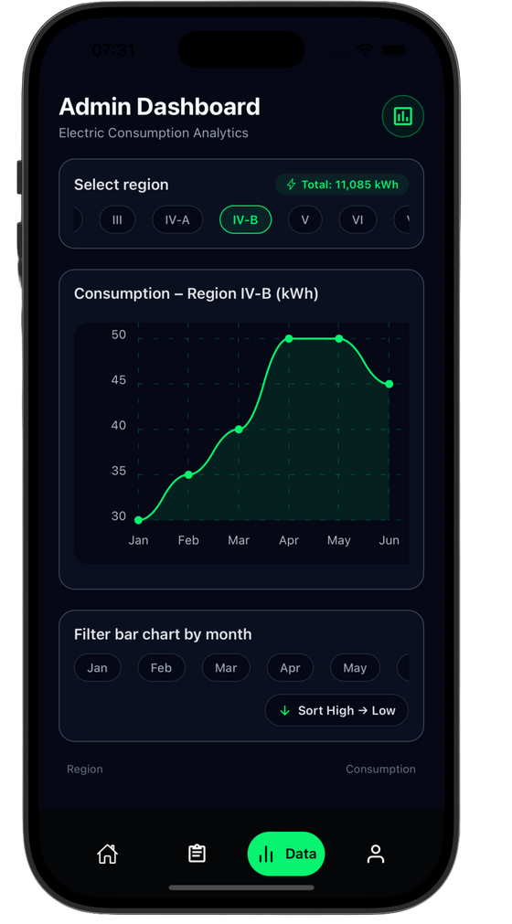

EV Use Monitoring
Collates EV use and trends from clusters into a dashboard for power monitoring and management

Slide 9
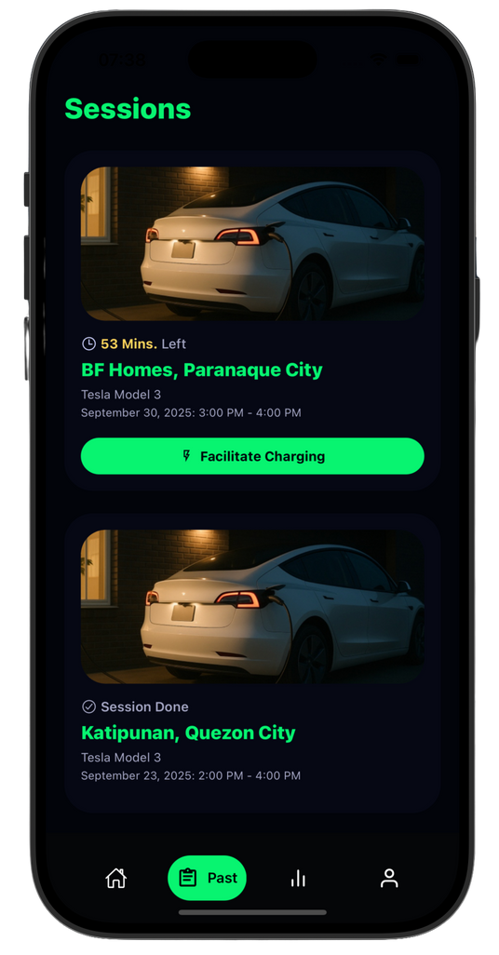
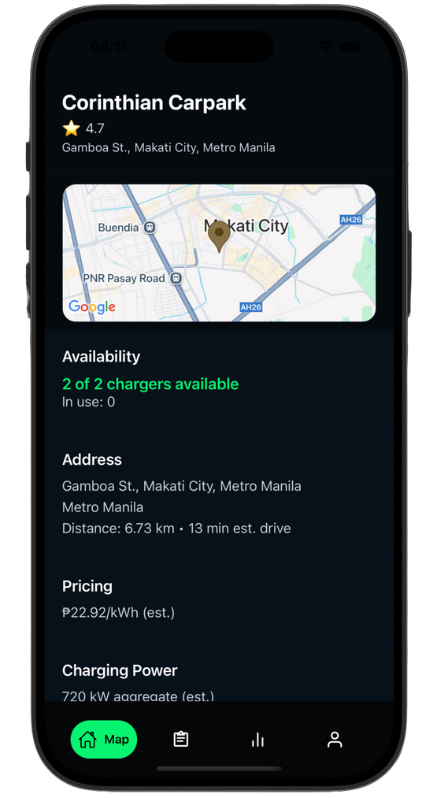
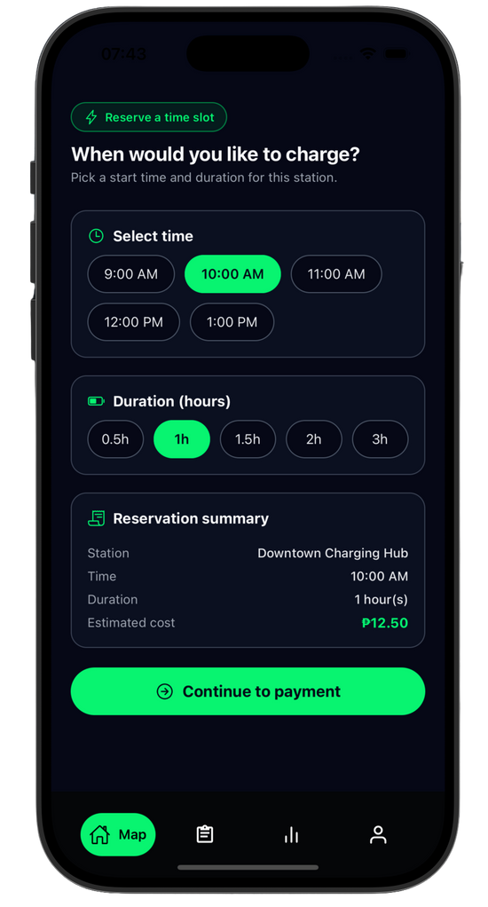
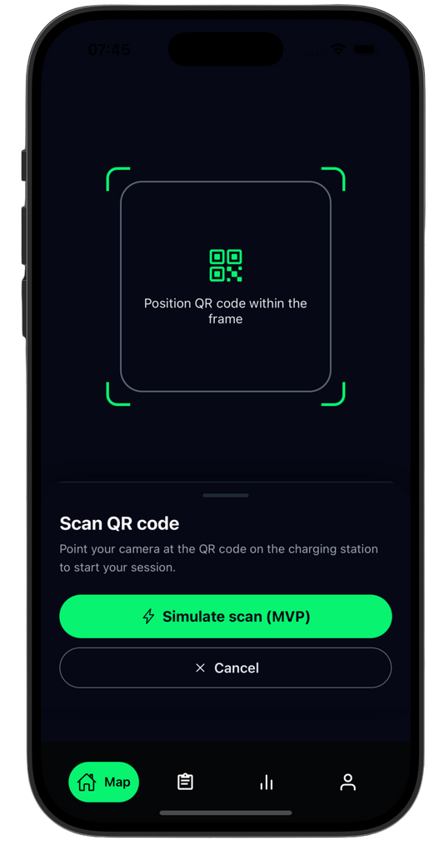
Peer-to-Peer Renting
Allows households and SMEs to join the charging network through the app linking them directly to EV drivers

Slide 10
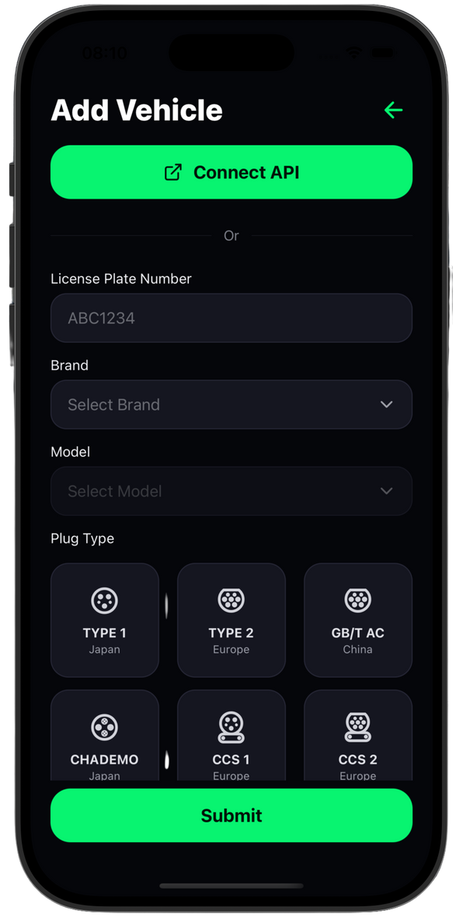

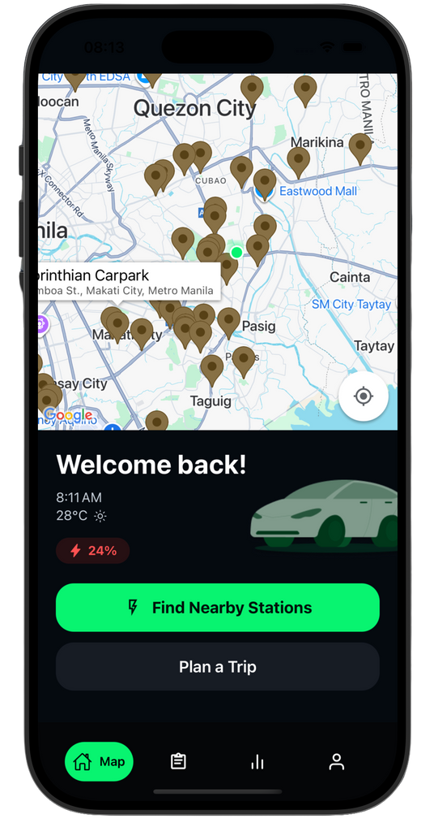




Technology Stack

Slide 11
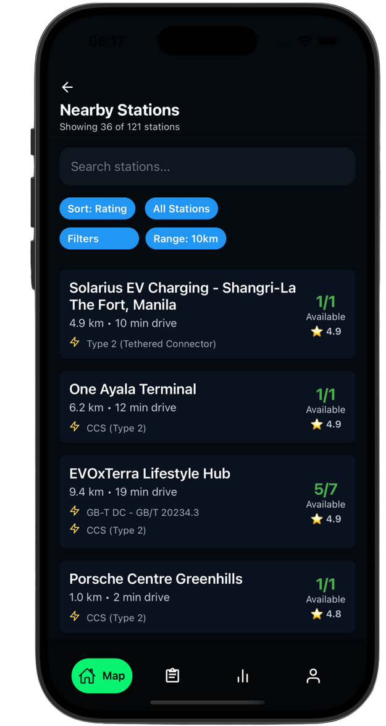



Business Model
Customer Revenue
fixed booking fee of 30 PHP
2% commission fee of the charging costs
Charger Owner Revenue
monthly listing fee in the app
Free Access
Commission Fee
Partnerships
SOM
5.6M PHP
SAM
37M PHP
TAM
100M PHP

Slide 12
Charging the Future of Sustainable Transport

